Slide 1
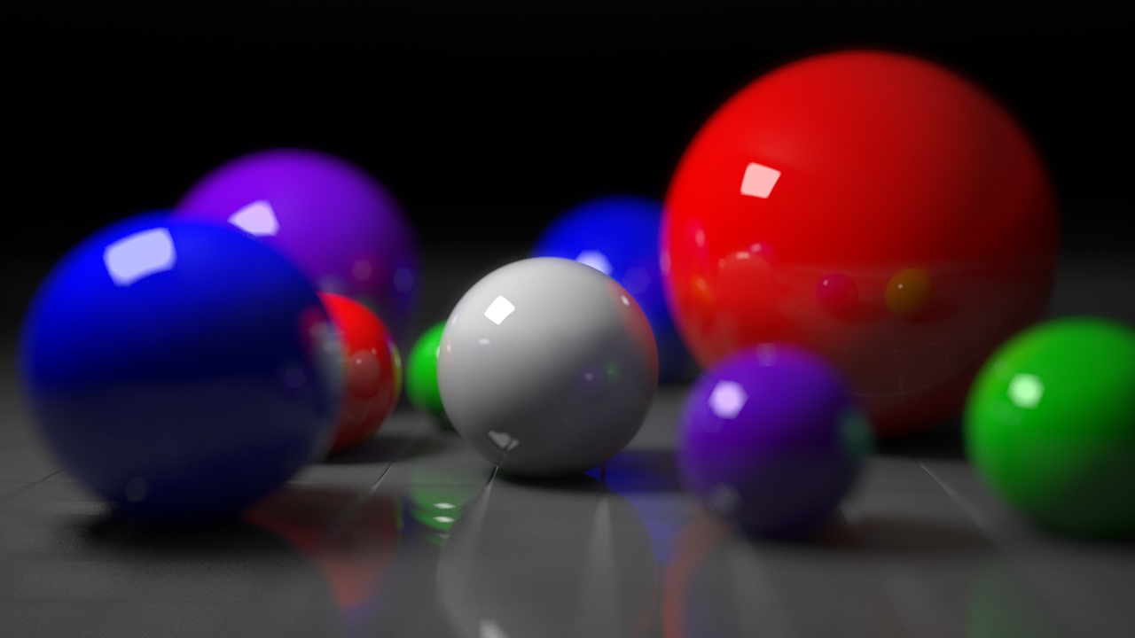
Photon Mapping
Jianyang Zhang, Xuyang Wang, Xuan Zhuang, Yufei Zhang

Slide 2

Introduction
A global approximate illumination algorithm
Simulate individual photons emitted from light sources
Generate photon maps for rendering
More realistic than pure raytracing techniques
Need more memory to store photon maps
Two passes: photon tracing, rendering

Slide 3

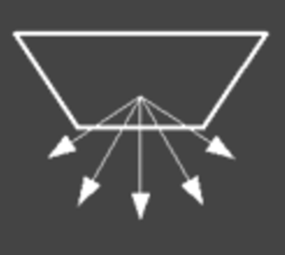
First Pass – Photon Tracing
Emit discrete photons from light source
Point light source vs. Area light source
Energy absorption, refraction and reflection
Material decides photon’s status after hitting surface
A photon is traced until it is absorbed or out of scene
point light source
area light source

Slide 4
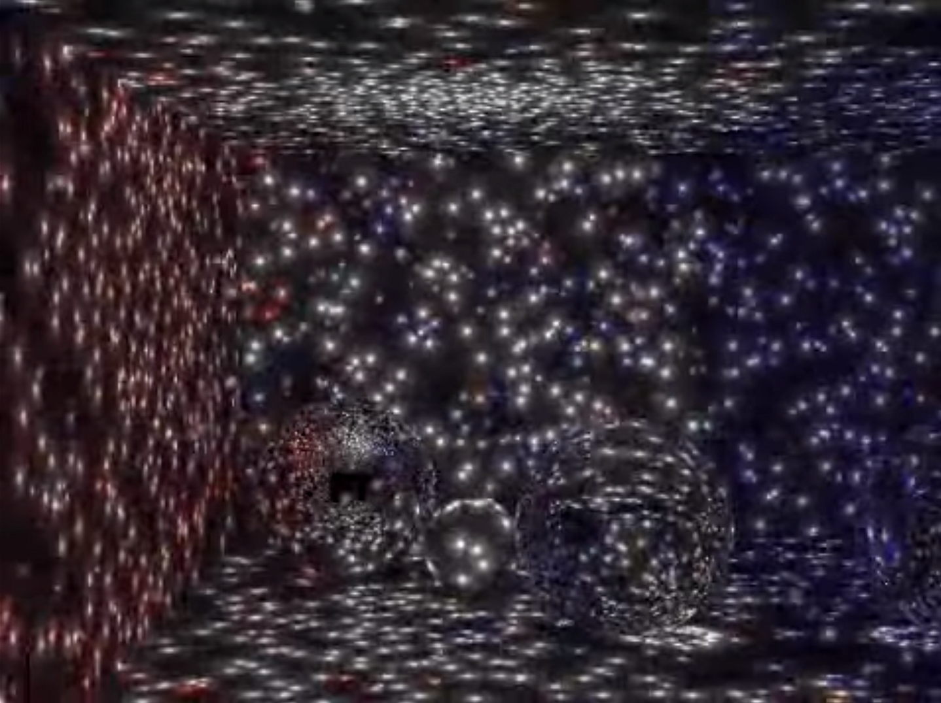
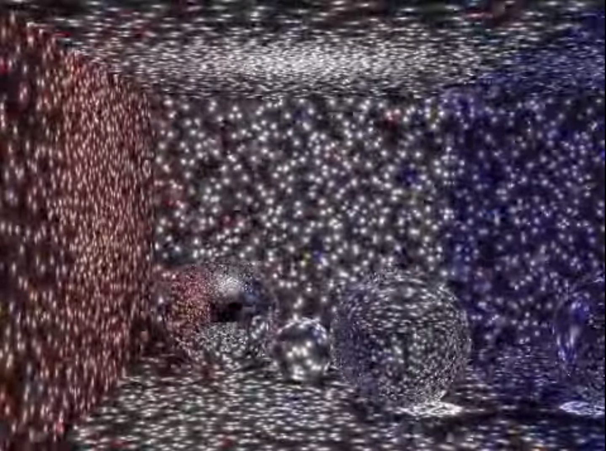
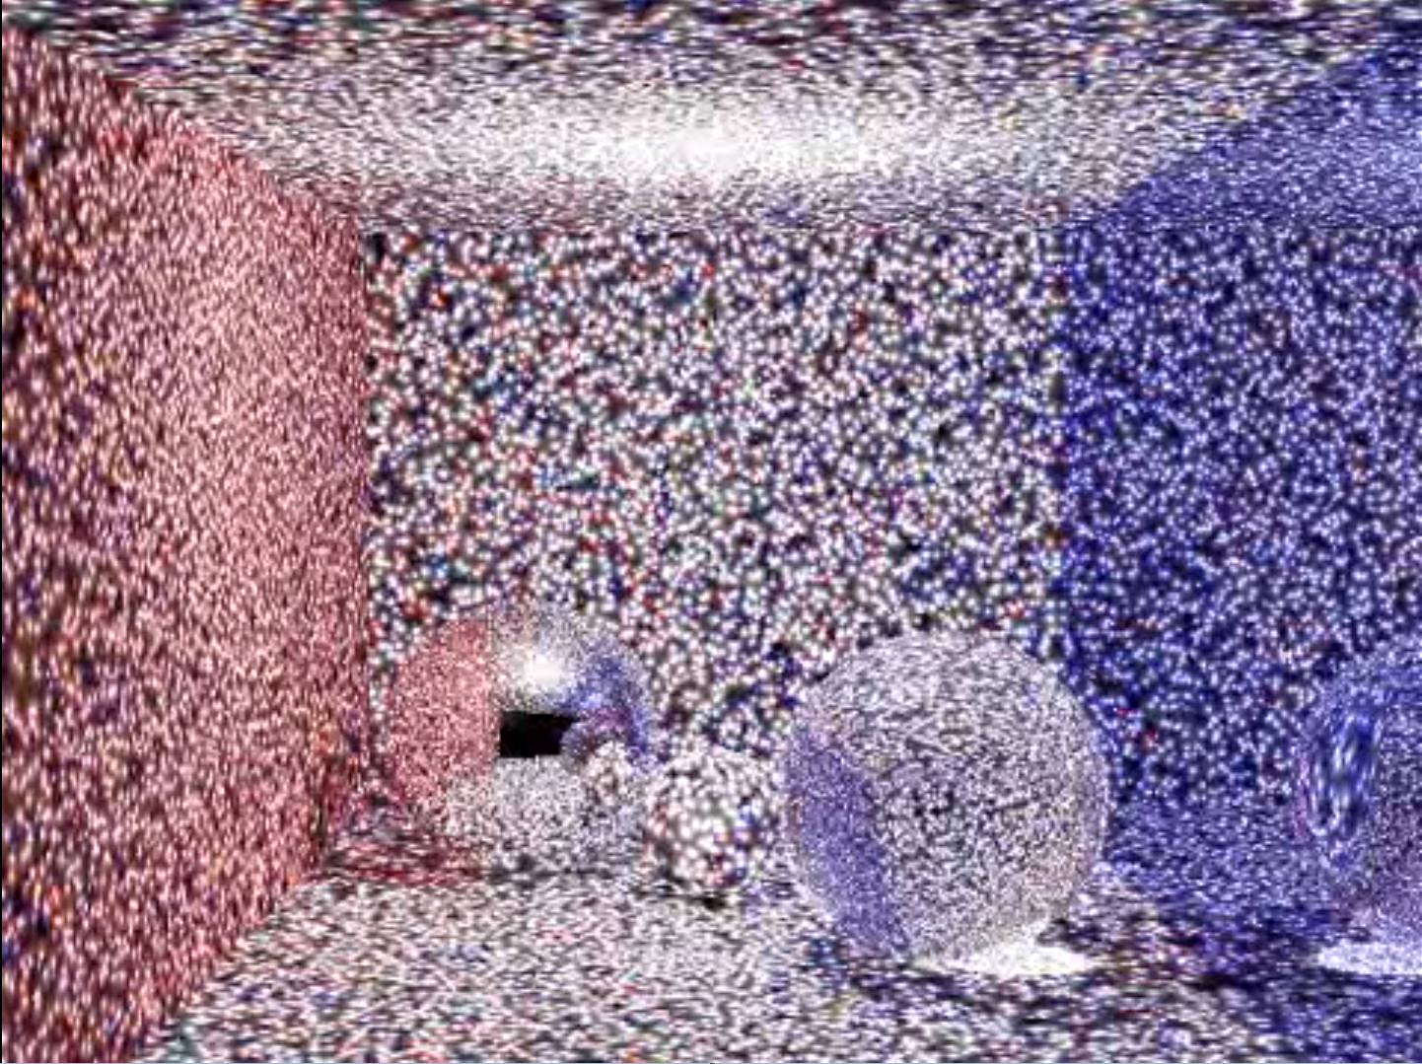
Second Pass – Rendering
Thousands of photons each bounce
Several bounces to generate photon maps
Visualize the photon maps by raytracing
More photons for more realistic result
First Bounce
Second Bounce
Third Bounce

Slide 5
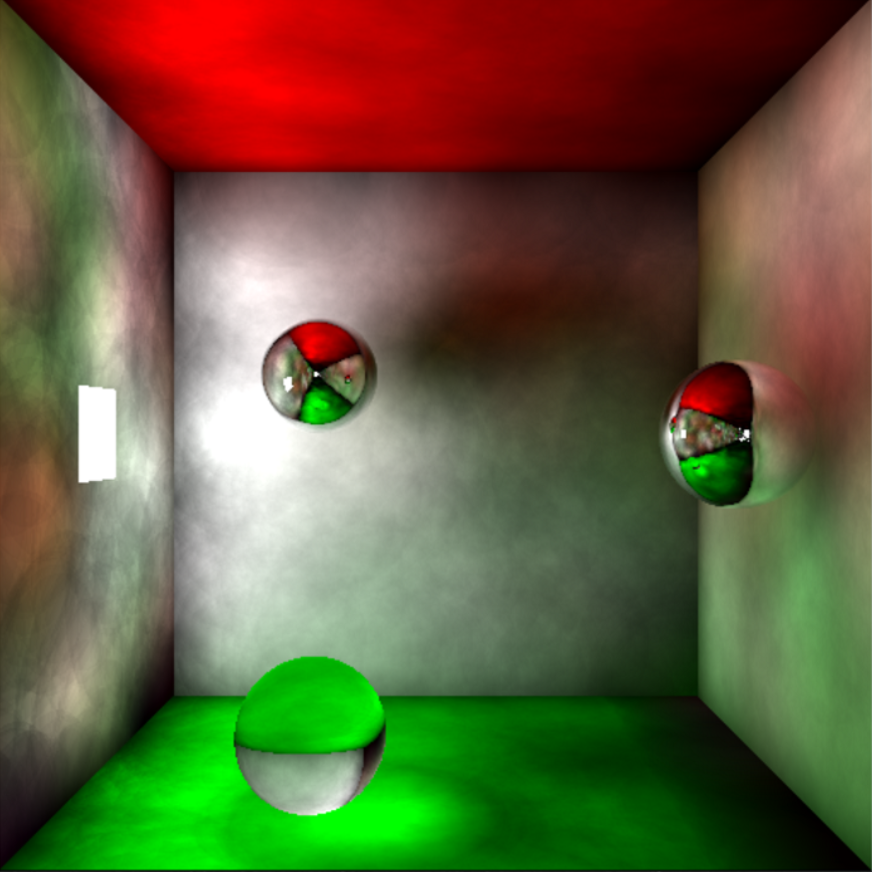
Basic Environment - Cornell box

Slide 6
Demo

